Slide 1
STMicroelectronics
SG8E L3-C3 Proposal
Redeployment of HCS02 Robots
OMRON Electronics Pte Ltd
OEP-SG/CRS
Jason Chai

Slide 2
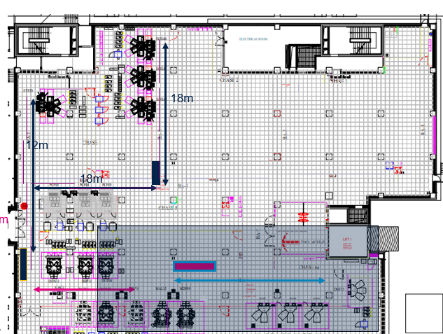
Customer Statement
Customer request OMRON to have a feasibility study at SG8E L3 – C3 Cleanroom for Re-deployment of HCS02 robots
Using current socket communication and message format
No E84 implementation

Slide 3
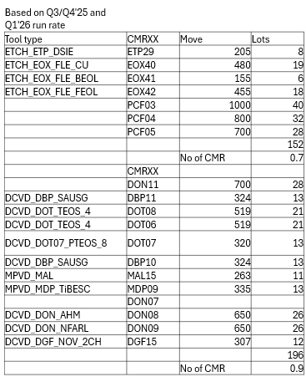
C3 Total number of tools and throughput
C3 Left Area
3 KLA tools with 3 SMIF Pod loader
4 Lam tools with 3 SMIF Pod loader
C3 Right Area
8 tools with 2 SMIF Pod loader
4 split - tools with 2 SMIF Pod loader
C3 Left Area
C3 Right Area

Slide 4
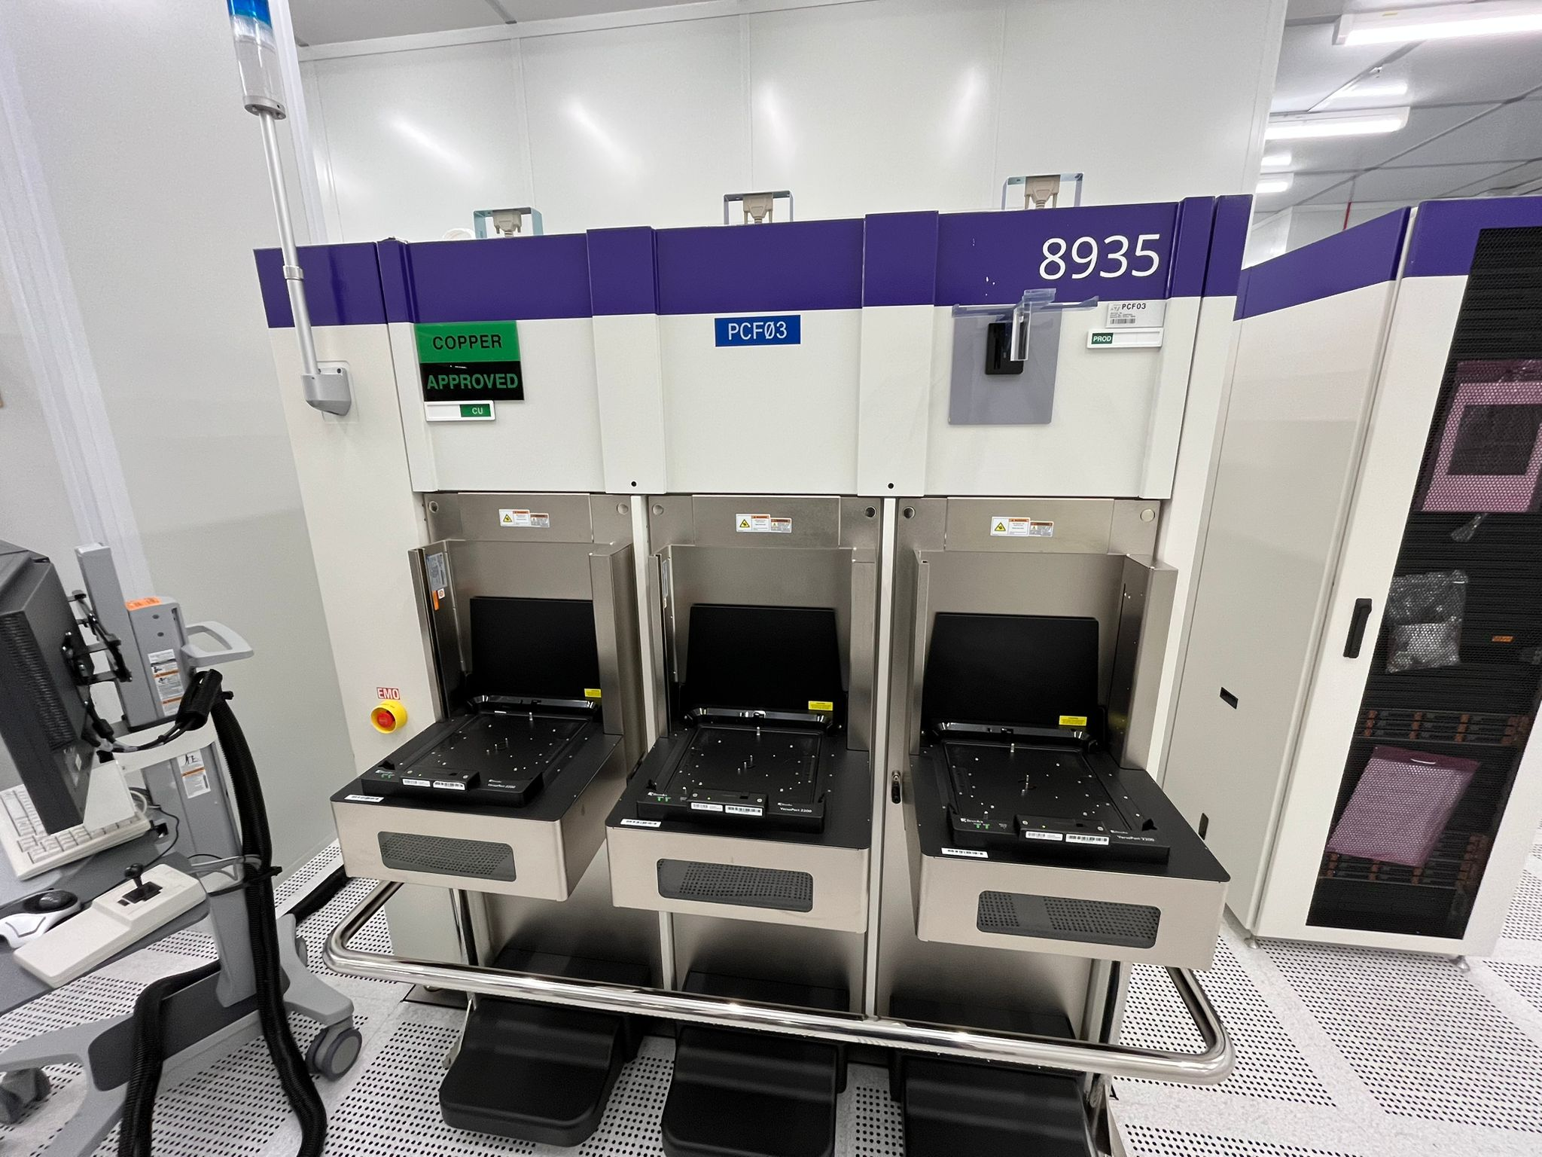
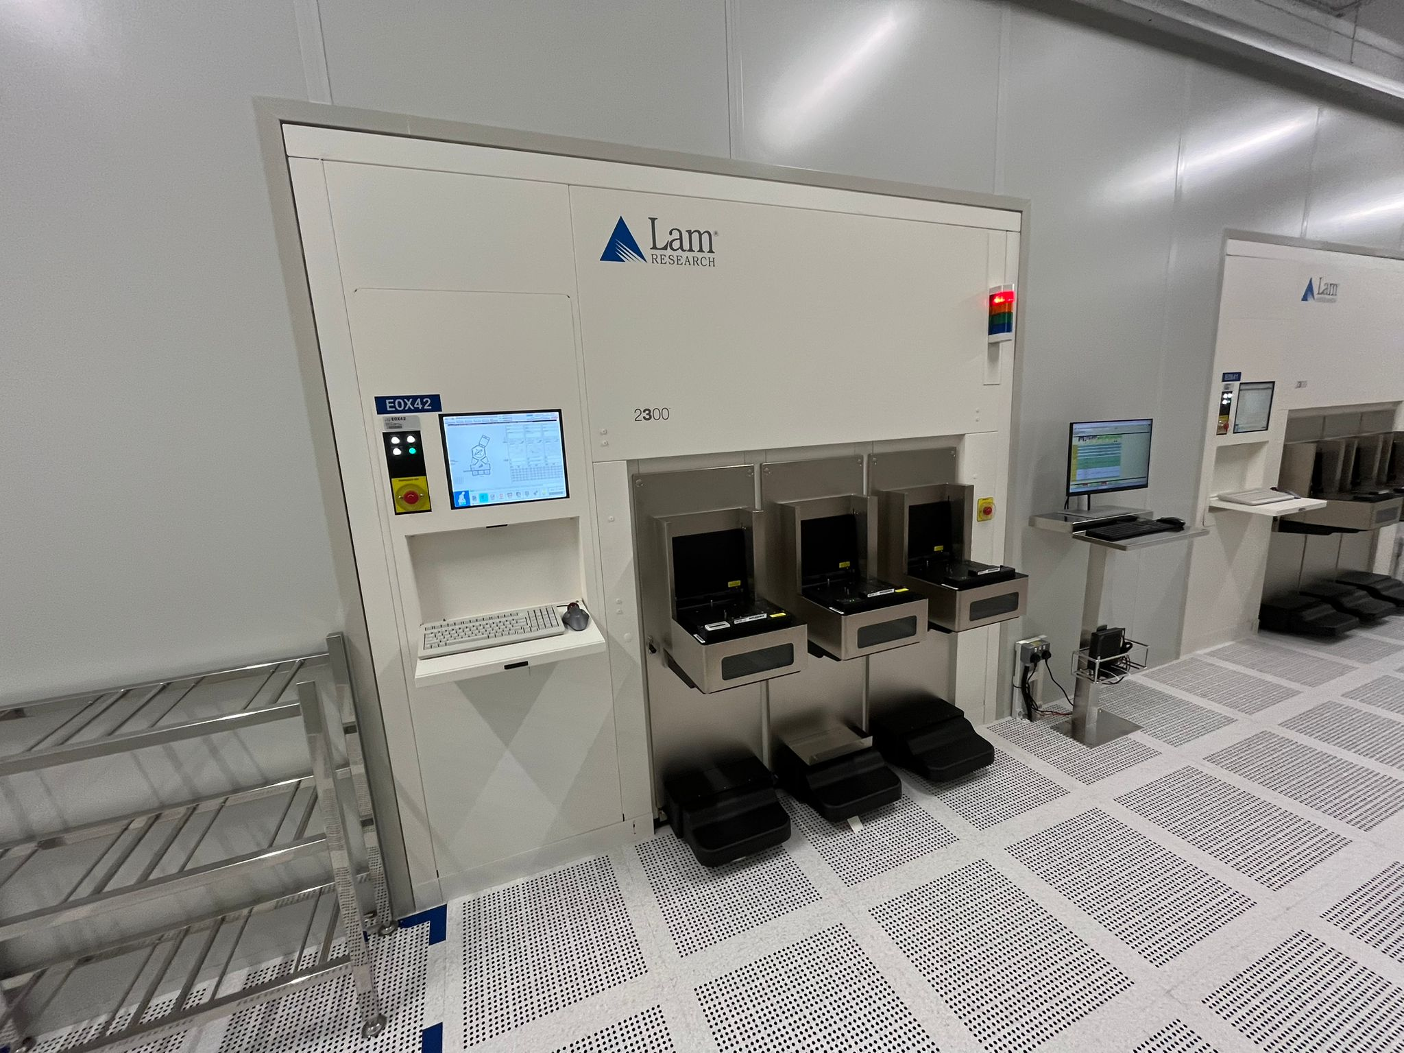
C3 Left Aea (Tool types)

Slide 5
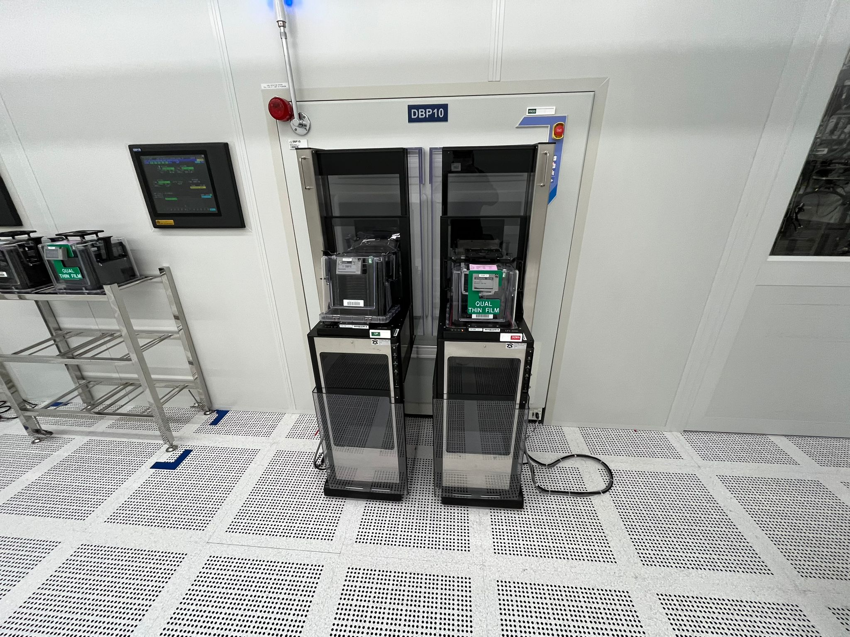
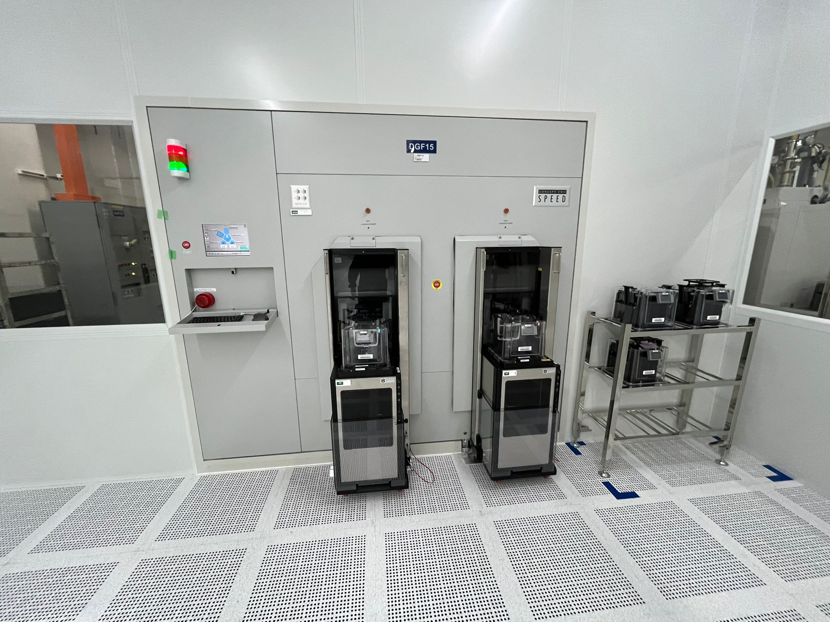
C3 Right Aea (Tool types)

Slide 6
OMRON Proposal
1. Smart rack for L3 or Add one more rack follow the old concept
2. C3 split into Left and Right working area
3. 1 input(18 slots) and output(12 slots) rack are required for one side (Left and Right working area)
4. CMR15 pick from L3 rack and place to left or right input rack at C3 according to tool name
5. Phase 2 robots will pick from C3 input rack and serve to the tool
6. After lot completed, phase 2 robot will pick from tool and place onto the C3 output rack
7. CMR15 will collect the lot from C3 output rack and transfer it to L3 rack

Slide 7
Process Flow
L3
C3
Input rack
CMR02
CMR04
smart rack or input
smart rack or input
Output rack
CMR15
Output rack
CMR06
HCS04
CMR05
Input rack

Slide 8
TM robot teaching and Mobile robot setup schedule
L3 Working Area
CMR15 ---> L3 2 racks (3 days)
CMR15 ---> C3 4 racks (5 days)
Left C3 Working Area
CMR02 ---> 3 KLA tools + 2 racks (4 days)
CMR04 ---> 4 Lam tools + 2 racks (5 days)
Right C3 Working Area
CMR05 ---> 8 tools + 2 racks (7 days)
CMR06 ---> 4 split tools + 2 racks (5 days)

Slide 9
Additional HCS programming (HCS04)
For a fully autonomous C3 area as per your request,
HCS04 will need to communicate with HCS02 Eracks and extensive program changes will be required.
Please refer to the table below on comparison of what needs to be changed for HCS04
Current HCS04 Requirements | New Proposed HCS04 Requirements
Detect based on limit switch sensor | Detect based on limit switch sensor AND read the Distag/barcode information to get Tool information, need to program.
Pickup from 1 Erack and Dropoff to 1 Erack | Pick up from 1 Erack and Dropoff to 2 Eracks
Can Dropoff to ANY available slot | Can Dropoff to only assigned tool Erack slot
Do not need to communicate to other HCS Erack | Need to communicate with HCS02 Racks

